Slide 1
DATA SCIENCE-BANKRUPTCY PREVENTION
NAME1: Priya Sanjay Jadhav
NAME: Harsha Moulika Nandyala
TOOLS :Python, Jupyter Note-book, MS Excel

Slide 2
OVERVIEW OF THE PROJECT
The project aims to develop a classification model predicting business bankruptcy probability using 7 features from 250 companies.
Six categorical predictor variables assess various business risks and strengths, with three levels of severity (low, medium, high).
The target variable is binary, indicating bankruptcy or non-bankruptcy.
The model will help identify companies at risk of bankruptcy, enabling proactive measures to prevent it.

Slide 3
Problem Statement
Objective
Benefits
We want to create a reliable tool that predicts bankruptcy risk. It should use data from many companies and look at key factors. The tool needs to be easy to understand and use. It should work for different types of businesses and explain its predictions. We'll test it to make sure it's accurate and compare it with other methods. The tool should respect privacy and be easy to update. We'll provide training and get user feedback to keep improving it.
A good bankruptcy prediction tool helps everyone make smarter choices. Banks can lend more safely. Investors can choose better companies. Businesses can fix problems before they get big. This keeps jobs safe and helps the economy. It builds trust in the business world. Companies can plan better for the future. It's useful for all kinds of decisions, from partnerships to mergers. Overall, it makes the business world more stable and healthy.
Companies can suddenly go bankrupt, causing problems for everyone involved. It's hard to predict which businesses might fail. Current tools aren't always accurate or easy to use. We need a better way to spot financial troubles early. This affects workers, investors, and communities. Different industries face unique risks.

Slide 4
Exploratory Data Analysis (EDA)
1.Distribution of class variable
2.Class Balance Pie Chart
3.Outlier Detection
4.Distribution of each Features
5.Correlation Matrix(Heat map)
6.Feature variables VS Target Variables
7.Pairplot for Multivariant Analysis
8.Feature values differ by Target values

Slide 5
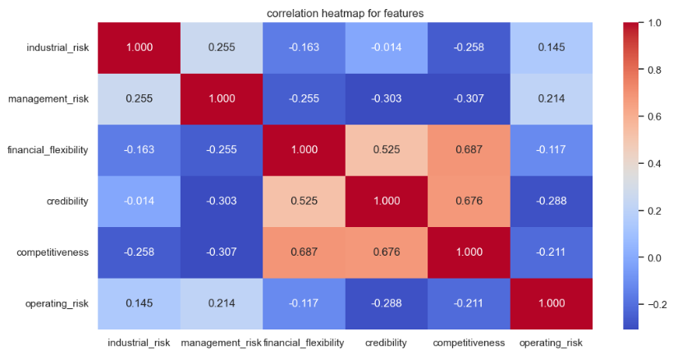
Key Insights from Exploratory Data Analysis
1.Financial Flexibility and Competitiveness
2. Operating Risk and Financial Flexibility
Strong positive correlation observed between financial flexibility and competitiveness (correlation coefficient: 0.68)
Companies with high operating risk have lower financial flexibility (-0.117)

Slide 6
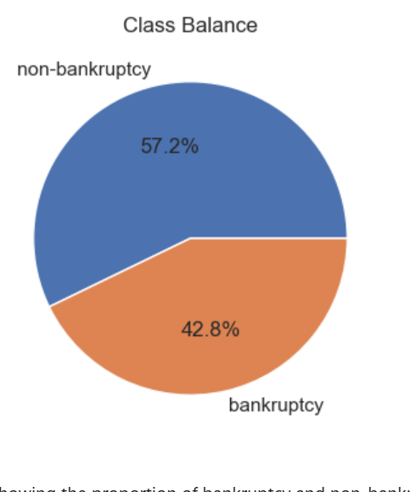
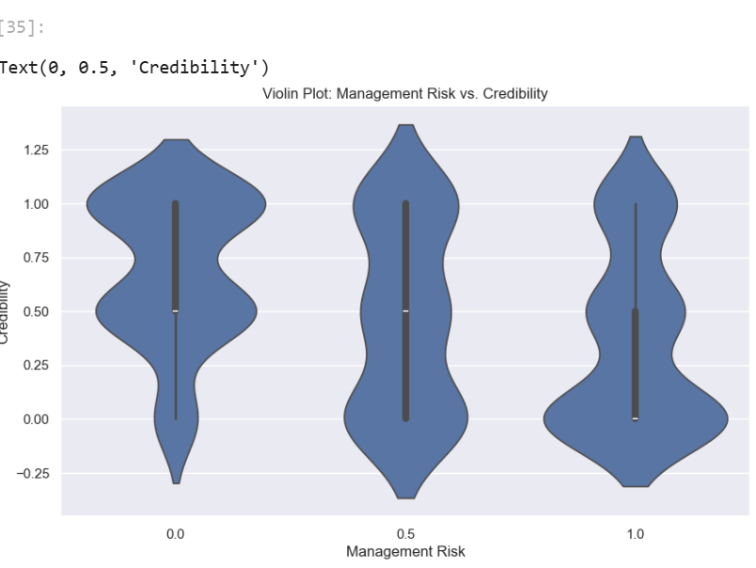
Class Distribution Imbalance
Class distribution shows a slight imbalance, with 42.8% of companies experiencing bankruptcy and 57.2% being non-bankrupt.
High management risk is associated with lower credibility ratings.

Slide 7
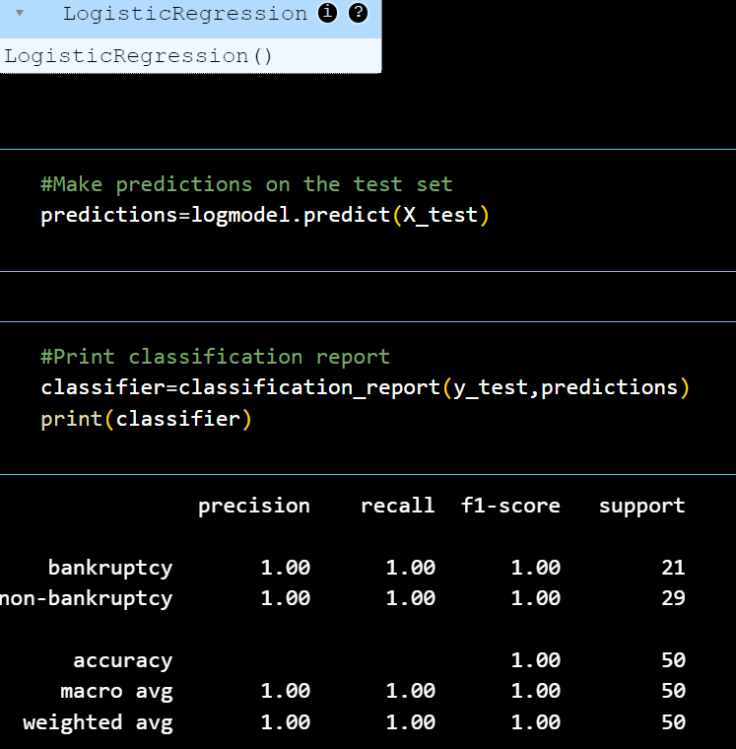
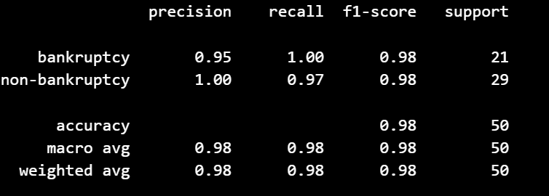
Model Building
Logistic Regression
1.Perfect Classification
2. Precision and Recall
3.Robust Performance
Decision Tree & Random Forest
1.High Accuracy
2.Balanced Precision and Recall
3.Consistent Performance

Slide 8
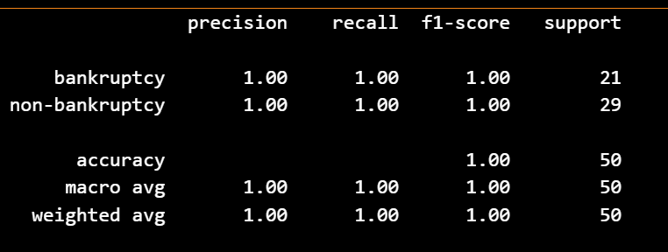
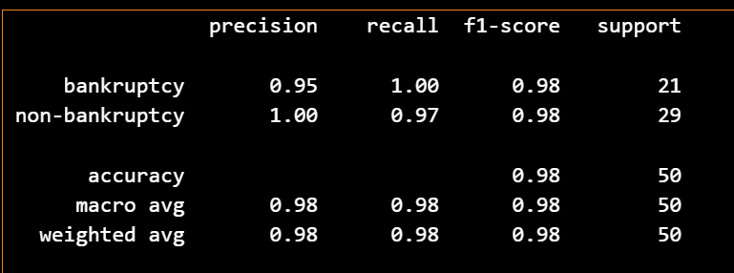
Model Building
Naïve Bayes
1.Perfect Classification
2. Flawless Precision and Recall
3. Unparalleled Consistency
Decision Tree & Random Forest
1.High Accuracy Across Kernels
2. Optimal Kernel Selection
3.Consistent Performance Metrics

Slide 9
Logistic Regression &Naïve Bayes
Both models achieved perfect accuracy:
Logistic Regression and Naive Bayes both achieved an accuracy of 1.00, indicating excellent performance in bankruptcy prediction.
Similar performance metrics:
Both models demonstrated similar precision, recall, and F1-score values, indicating consistent performance across both classes.

Slide 10
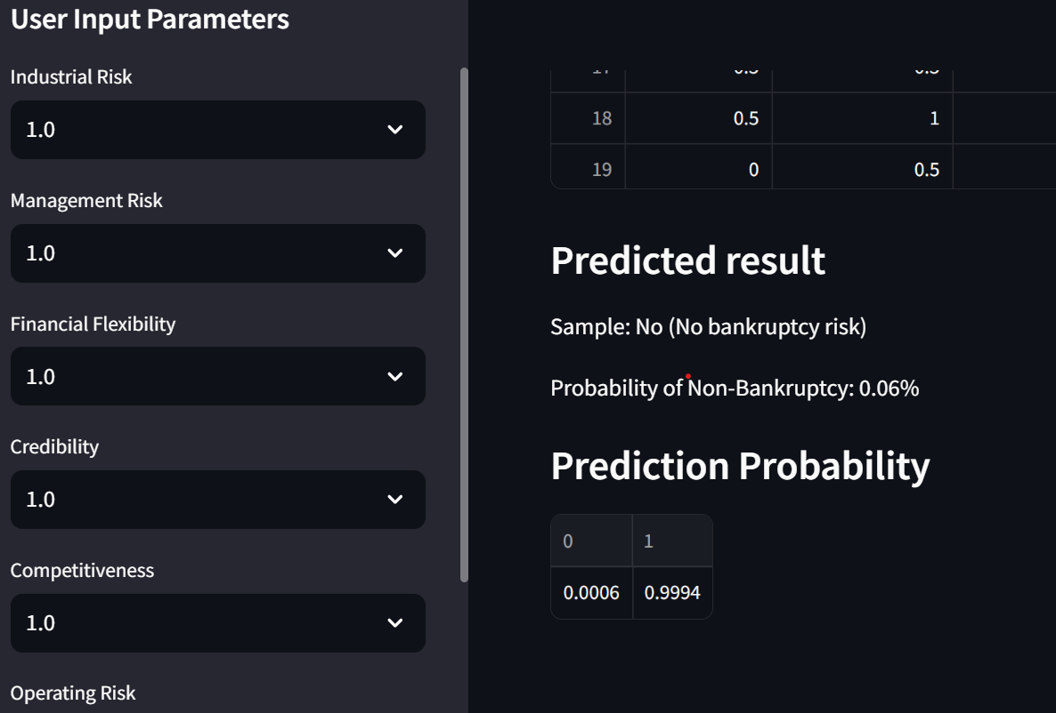
LOGISTIC REGRESSION DEPLOYMENT

Slide 11
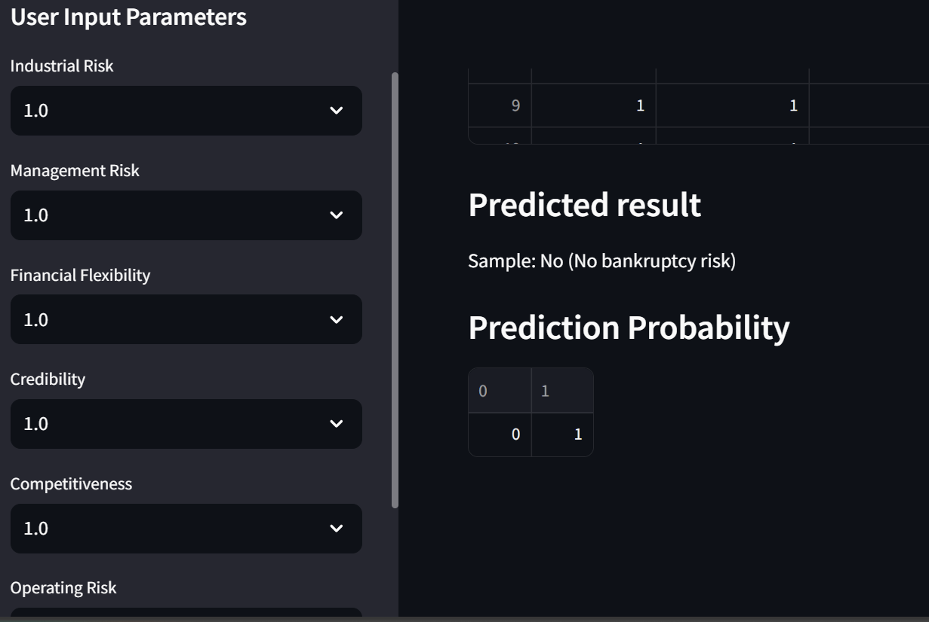
NAÏVE BAYES DEPLOYMENT

Slide 12
 | Logistic Regression | Naïve Bayes
Deployment | Logistic Regression is widely used in various applications, including large-scale datasets | Naive Bayes is typically used for small to medium-sized datasets
Speed | Logistic Regression can be slower to train and predict compared to Naive Bayes, especially with large datasets. | Naive Bayes is generally faster to train and predict compared to Logistic Regression.
Assumptions | Does not assume independence between features, making it more robust to correlated data. | Assumes independence between features, which can lead to inaccurate results if features are highly correlated.
Hyperparameters | More hyperparameters to tune, such as regularization strength and solver algorithms. | Few hyperparameters to tune.

Slide 13
Conclusion
“Identification of missing values and outliers in the data.”
“ Understanding of the distribution of financial variables and their relationships.”
“Detection of class imbalance between bankrupt and non-bankrupt companies.”
“Correlation analysis revealed important relationships between financial features.”
5. “visualization helped identify patterns and trends in the data.”
6. “Logistic Regression: Simple, interpretable, efficient for linearly separable data, provides clear probability estimates.”
7. "Naive Bayes: Computationally efficient and fast in making predictions, Requires less training data compared to many other algorithms.“
8. “Users can compare predictions from both models for a more comprehensive view.”
9. “Accessible to both technical and non-technical users.”
10. “Simple and fast, especially for large datasets Performs well with high-dimensional data Effective even with small training datasets.”

Slide 14

Future Directions
Future Directions:
Continuous monitoring of both models' performance in real-world scenarios
Potential for incorporating ensemble methods to combine predictions
Exploring ways to visualize and explain Naïve Bayes predictions for better interpretability
Gathering user feedback to refine the interface and model selection
By deploying both Logistic Regression and Naive Bayes models, we've created a versatile and powerful tool for bankruptcy prediction. This approach acknowledges that different situations may benefit from different modeling techniques, and provides users with a comprehensive view of potential bankruptcy risks. The Streamlit deployment ensures that this sophisticated analysis is accessible and user-friendly, potentially improving financial decision-making across various sectors.

